Slide 1


Evaluation Metrics
Luis Miralles

Slide 2

Classification Metrics

Slide 3
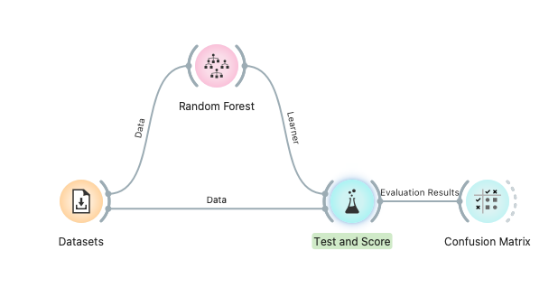
Classification Metrics
Orange pipeline for creating a Confusion Matrix

Slide 4
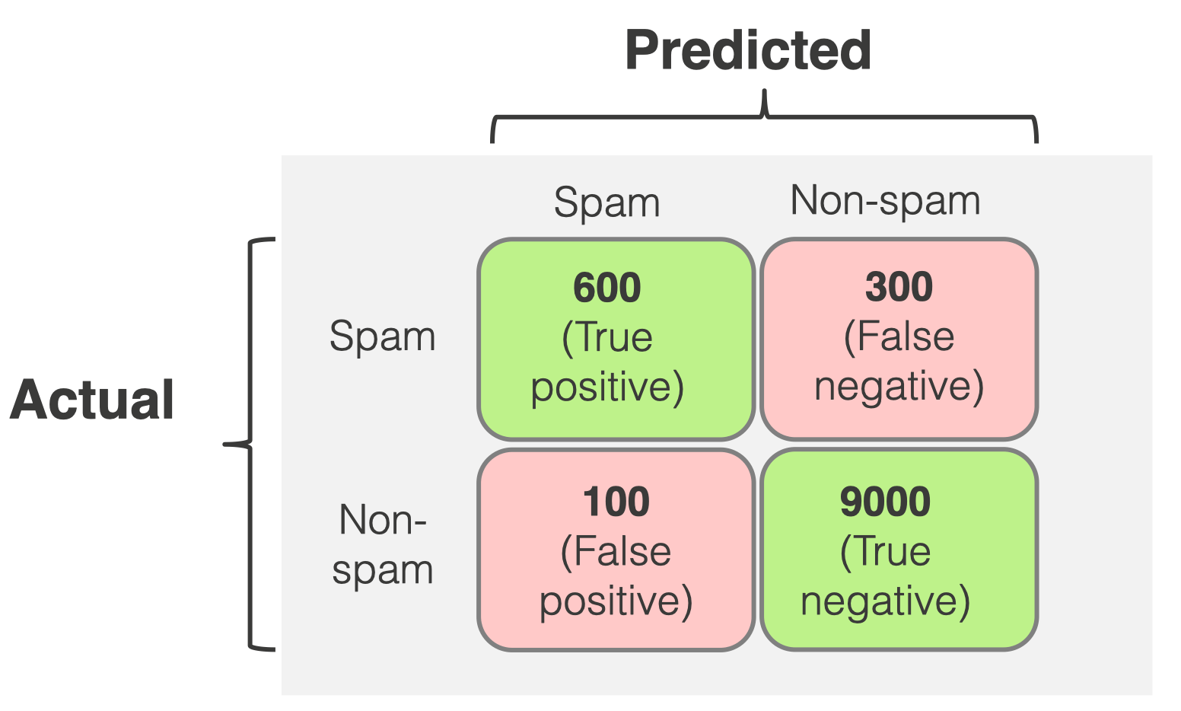
Confusion matrix
Predicted value of
the elements
Real value of
the elements

Slide 5
False positive, True negative, False positive and False Negative
True Positive (TP) refers to the number of predictions where the classifier correctly predicts the positive class as positive. E.g., The user suffers from diabetes and is predicted as diabetic.
True Negative (TN) refers to the number of predictions where the classifier correctly predicts the negative class as negative. For example, The user does not suffer from diabetes and is predicted as not diabetic.
False Positive (FP): It refers to the number of predictions where the classifier incorrectly predicts the negative class as positive. E.g., The user does not suffer from diabetes and is predicted as diabetic.
False Negative (FN): It refers to the number of predictions where the classifier incorrectly predicts the positive class as negative. For, The user suffers from diabetes and is predicted as non-diabetic.

Slide 6
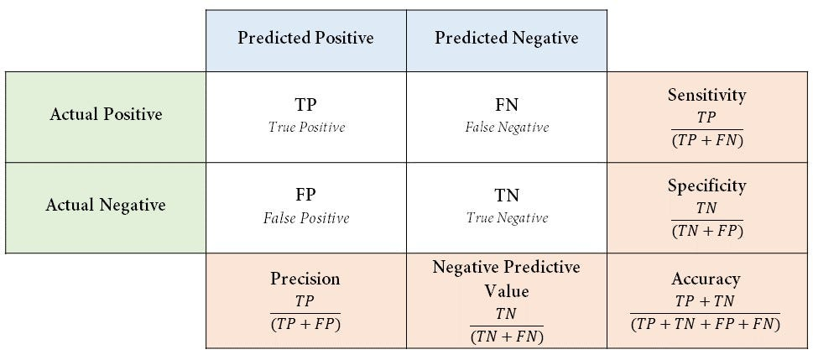
Confusion Matrix
https://medium.com/@danyal.wainstein1/understanding-the-confusion-matrix-b9bc45ba2679

Slide 7
Main metrics
Classification accuracy is the proportion of correctly classified examples.
Precision is the proportion of true positives among instances classified as positive, e.g. How many predicted as diabetic are diabetic.
Recall is the proportion of true positives among all positive instances in the data, e.g. the number of diabetics among all diagnosed as diabetic.
Specificity is the proportion of true negatives among all negative instances, e.g., non-diabetic individuals diagnosed as non-diabetic.
F-1 is a weighted harmonic mean of precision and recall.

Slide 8
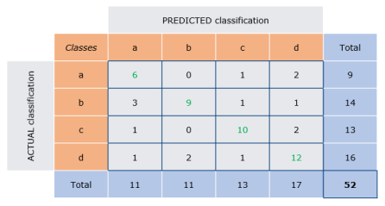
Confusion Matrix for multiple classes
https://www.arxiv-vanity.com/papers/2008.05756/

Slide 9
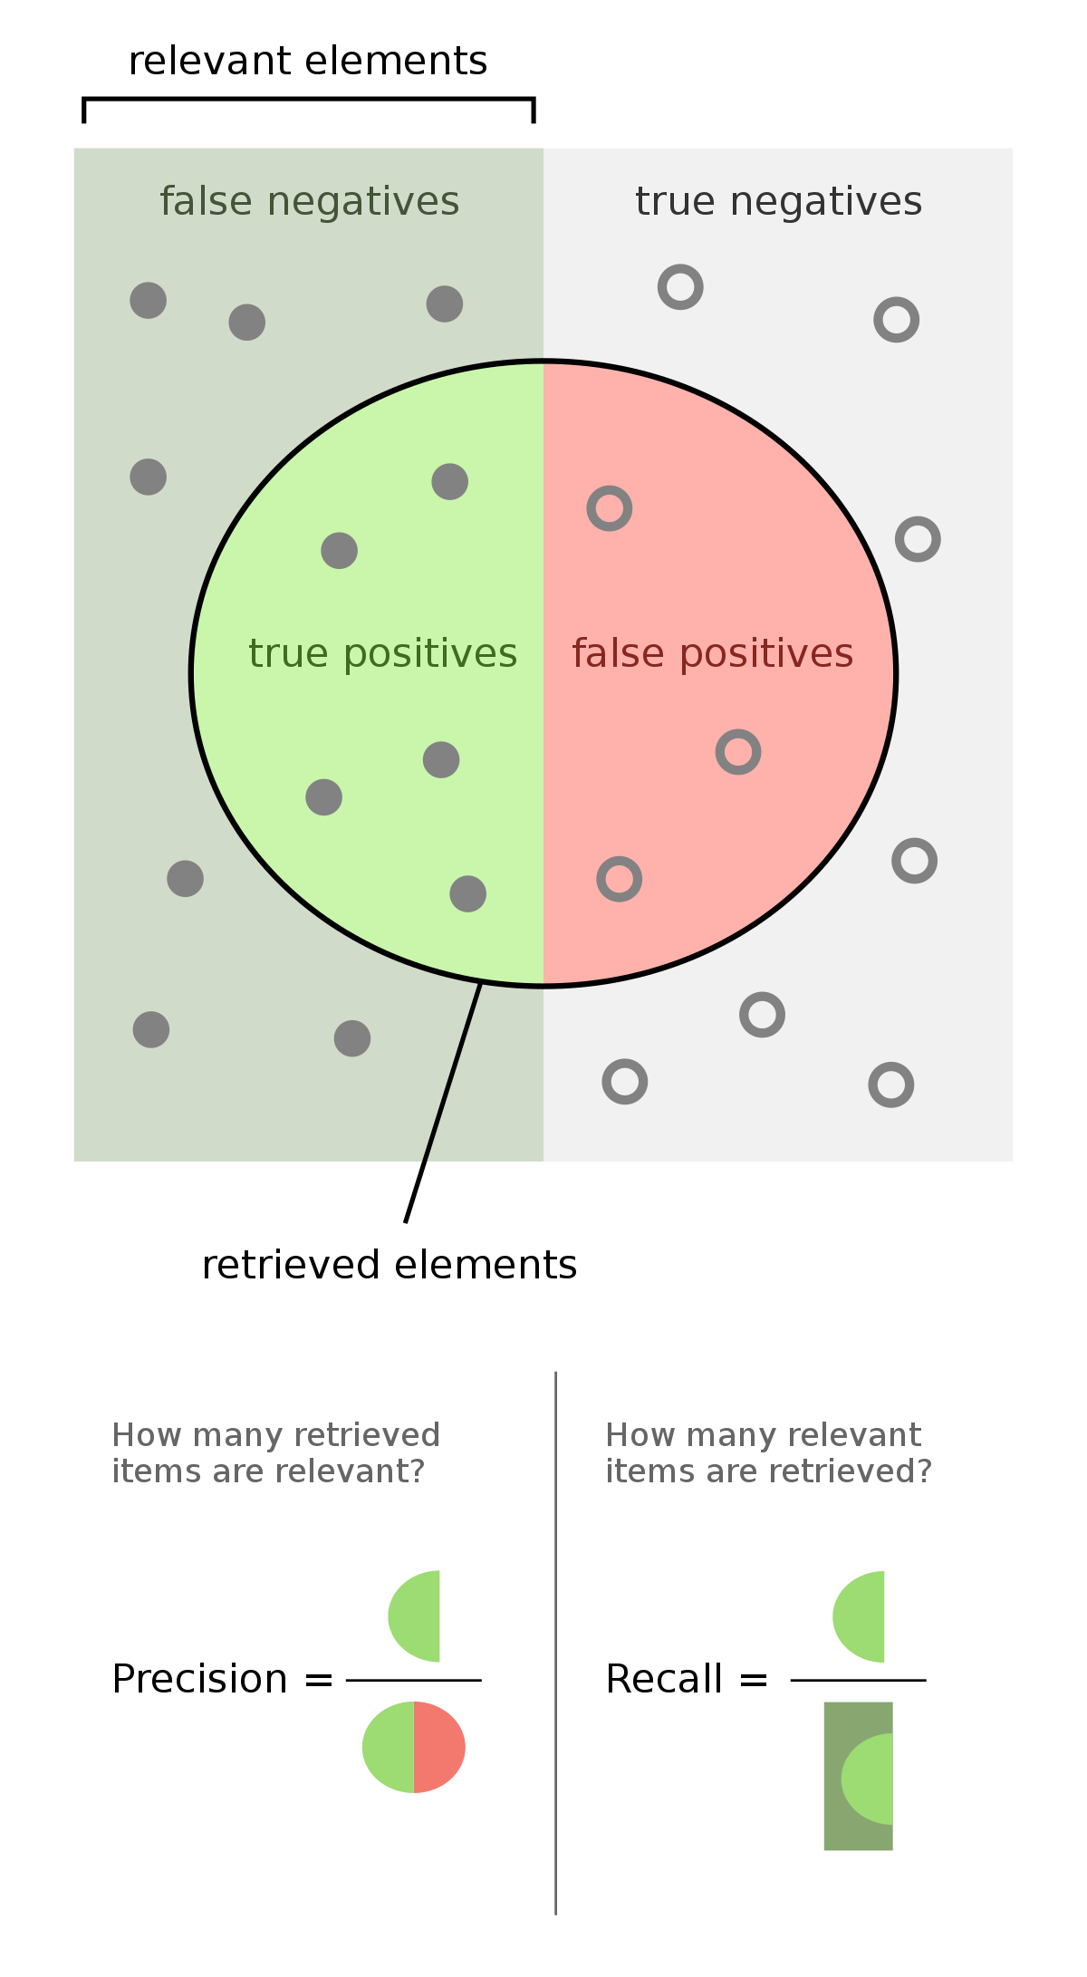
Precision and Recall
Spam messages
Percentage of predicted as spam are really spam
Predicted as spam
Percentage of spam messages predicted as spam

Slide 10
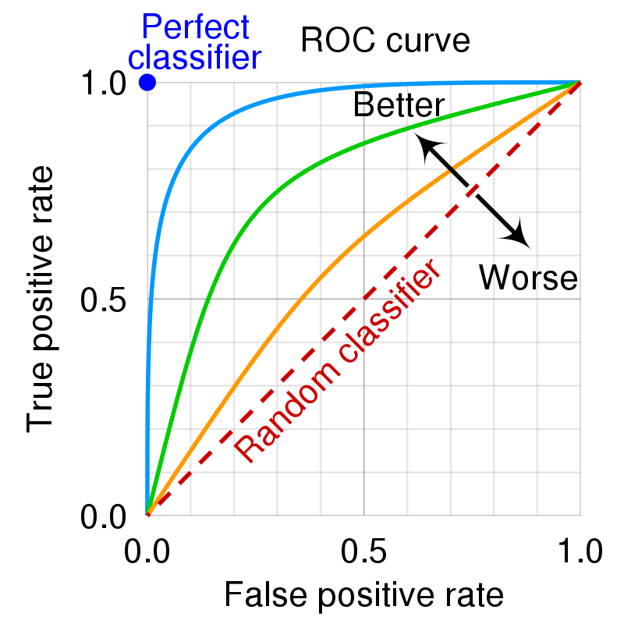
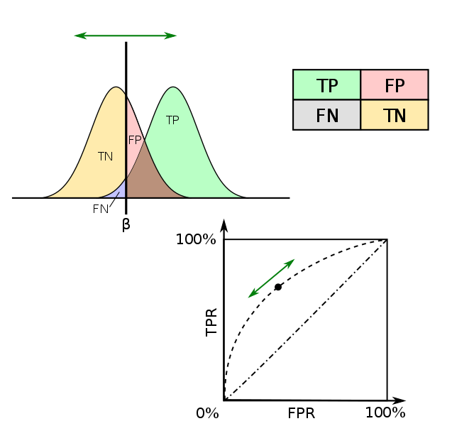
What is ROC?
High values
are good
High values
are bad
https://devopedia.org/roc-curve

Slide 11
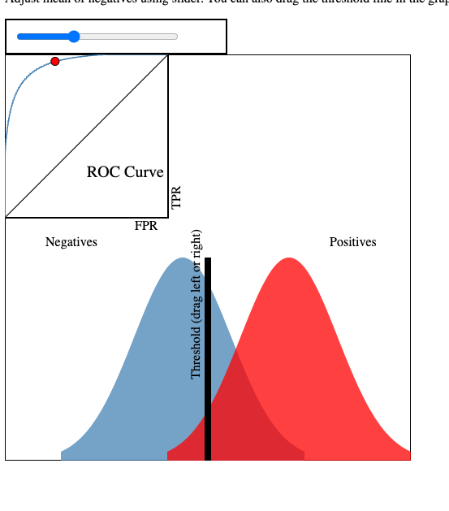
Online Tool
http://www.navan.name/roc/?ref=dataschool.io

Slide 12

Cross-validation and when to use it
https://vitalflux.com/k-fold-cross-validation-python-example/

Slide 13

Regression Metrics

Slide 14
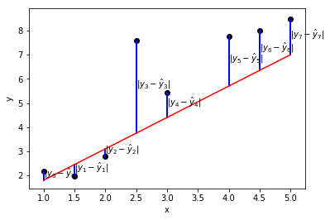
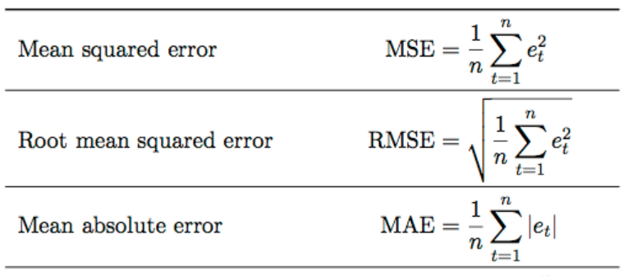
Regression metrics

Slide 15
References
https://orangedatamining.com/widget-catalog/evaluate/testandscore/

